Slide 1
Destination: Convolutional Neural Networks

Slide 2

Convolutional Neural Networks Applications
Facial Recognition
Link to video: https://www.youtube.com/watch?v=vC3bTziLRTA

Slide 3

Convolutional Neural Networks Applications
Deep Nostalgia
By MyHeritage
Animates (old) photos
Went viral in February 2021
https://www.myheritage.com/deep-nostalgia
https://blog.myheritage.com/2021/02/deep-nostalgia-goes-viral/

Slide 4
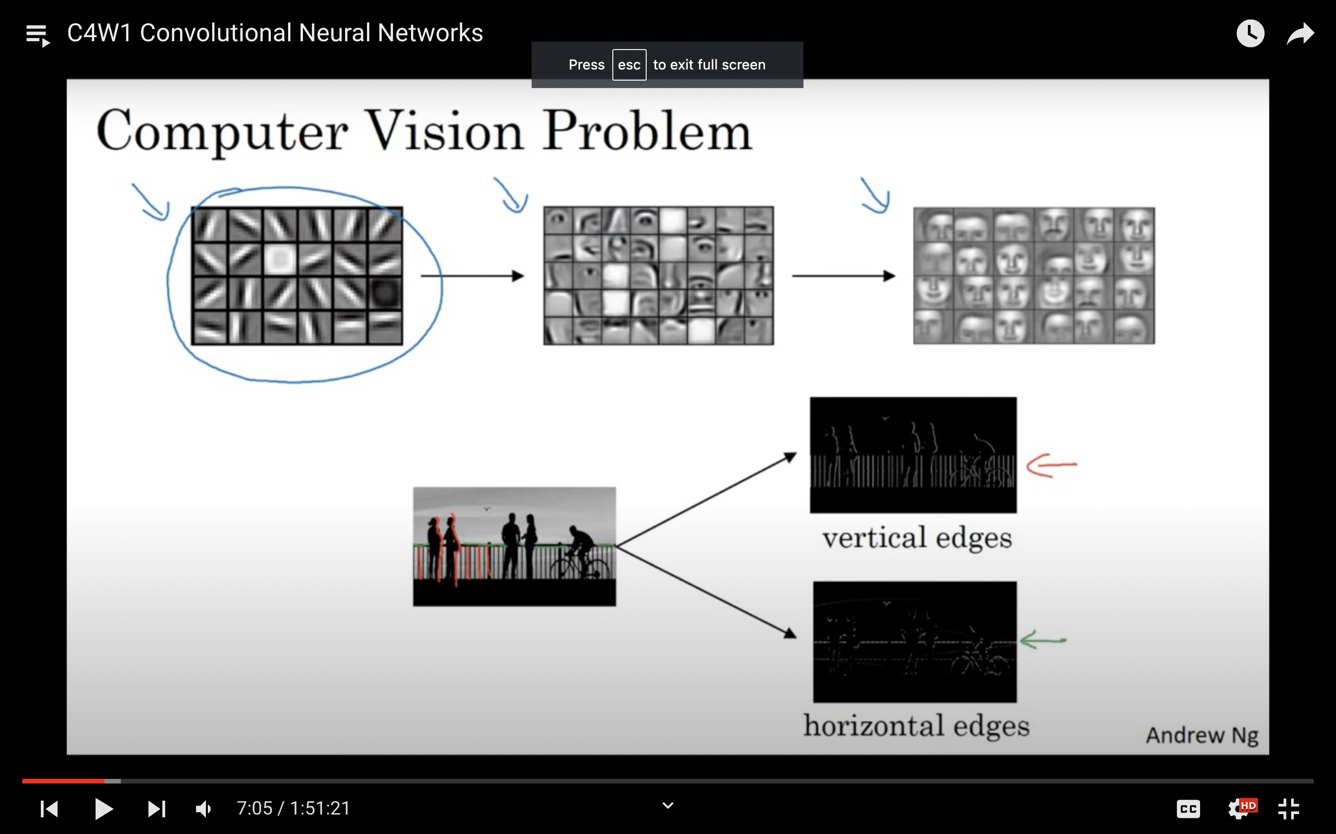
Computer Vision
Feature Detection

Slide 5
Computer Vision
Edges Detection

Slide 6
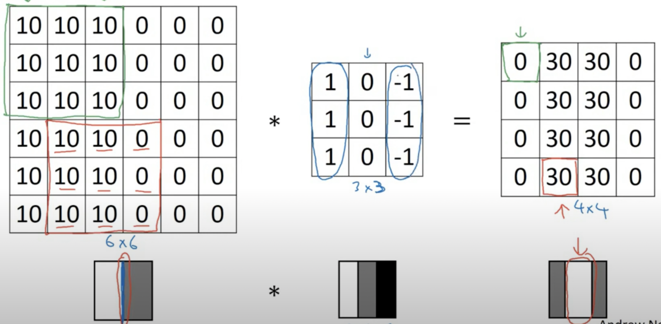
Computer Vision
Vertical
Edges Detection

Slide 7
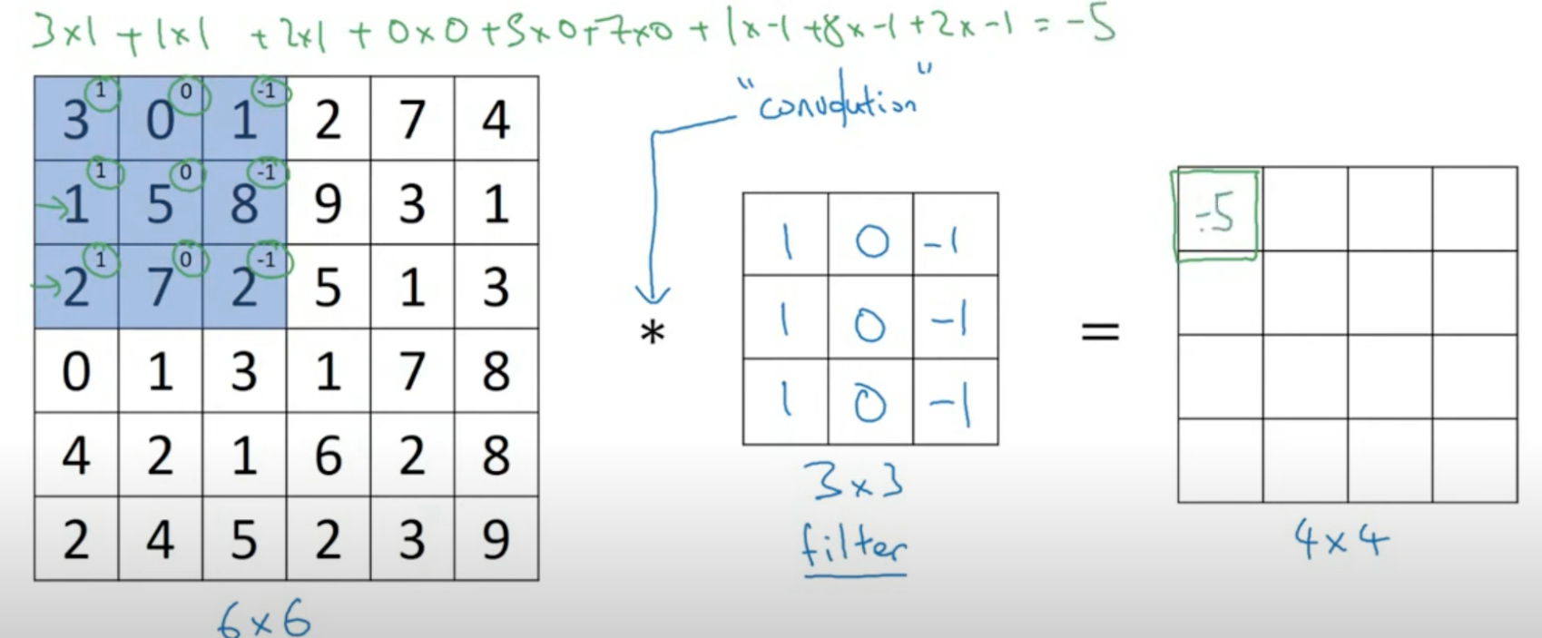
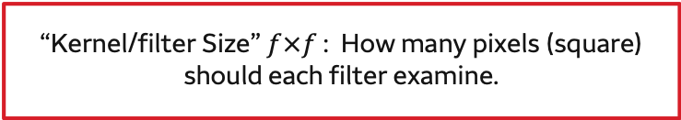
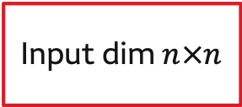

Convolutional Neural Networks
Recommended Video: https://www.youtube.com/watch?v=0MTaMxGhSws
Convolution Calculation:$n×n$ * $f×f$ = $(n−f+1) ×(n−f+1)$
Input dim $n×n$
model.add(Conv2D(1, 3, 1, input_shape=(6, 6, 1), padding='same', activation='relu'))
Number of Filters
“Kernel/filter Size” $f×f$ : How many pixels (square) should each filter examine.

Slide 8
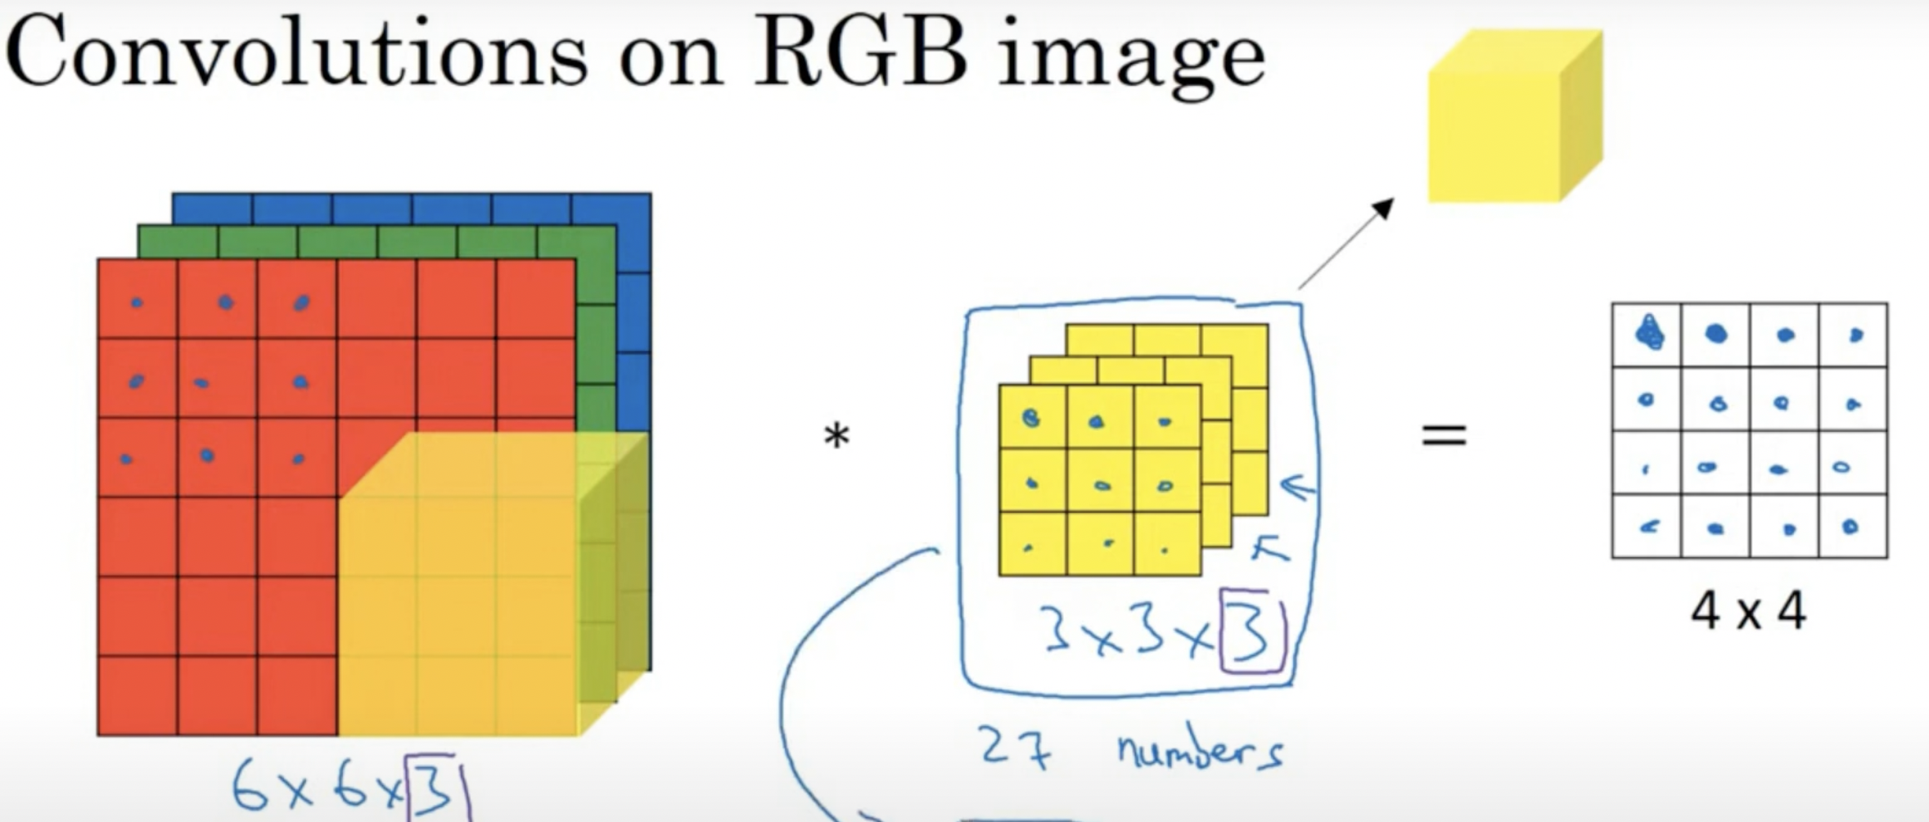
Convolutional Neural Networks

Slide 9
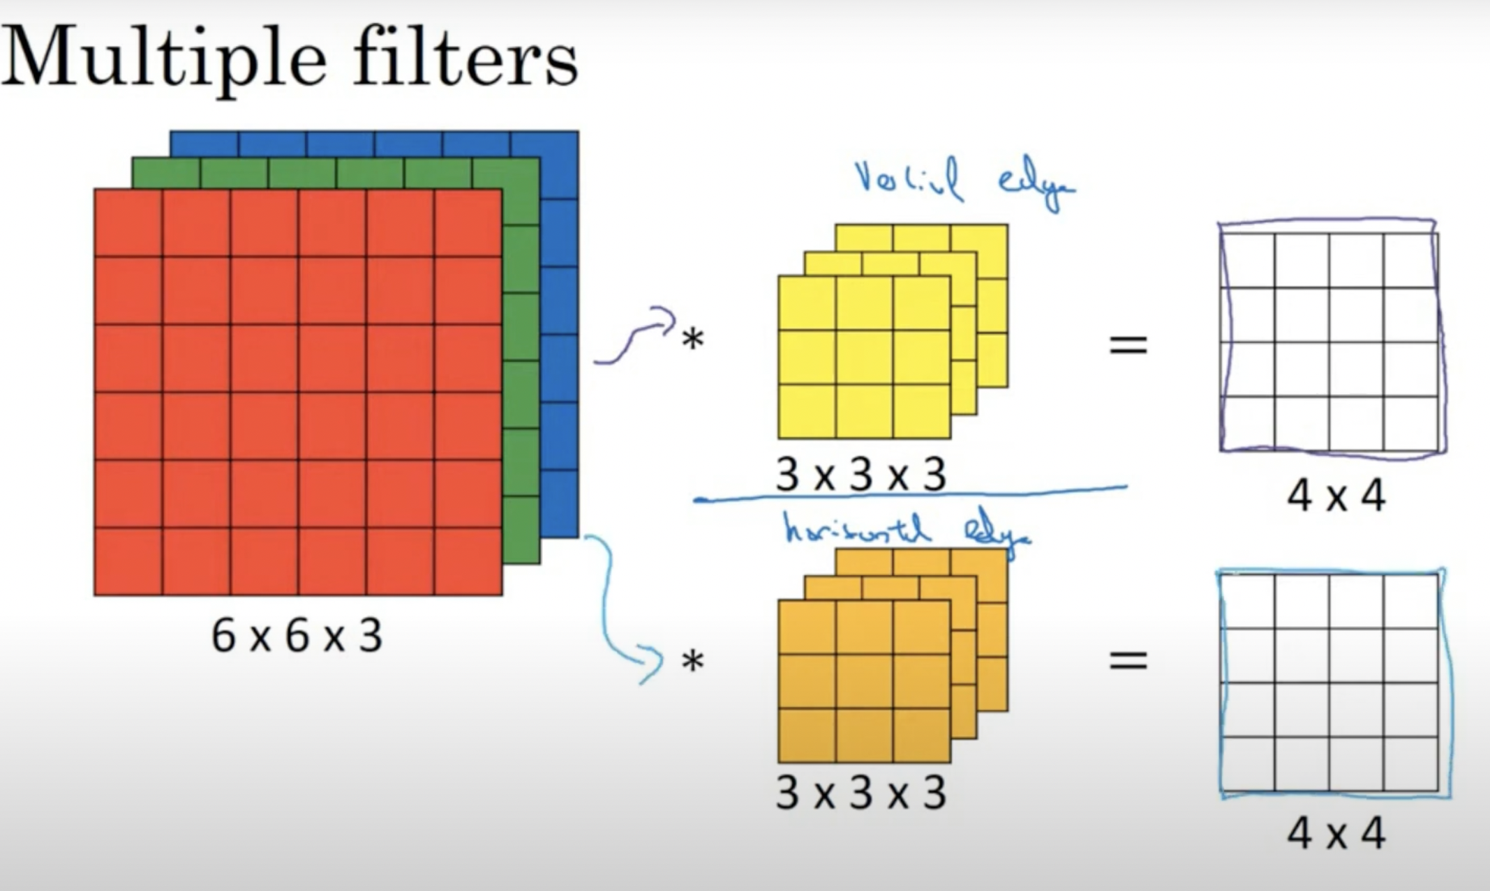
Convolutional Neural Networks

Slide 10
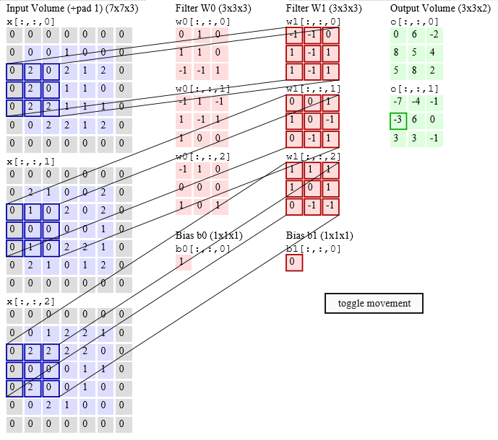
Convolutional Layers Illustration
Visit: http://cs231n.github.io/assets/conv-demo/index.html for an illustration.

Slide 11
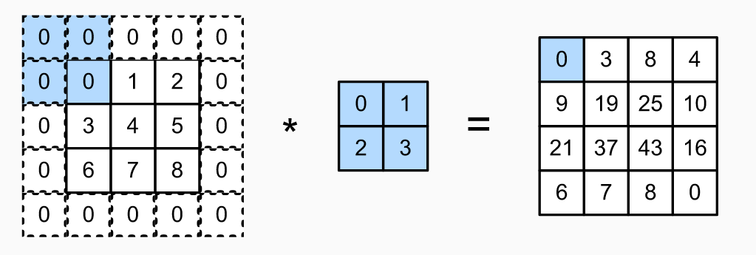

Convolutional Neural Networks
Padding:$n×n$ * $f×f$ with p = $(n+2p−f+1) ×(n+2p−f+1)$
Same Padding: pad so that output size is the same as the input size
model.add(Conv2D(64, 8, 8, input_shape=(64, 64, 1), padding='same', activation='relu'))

Slide 12
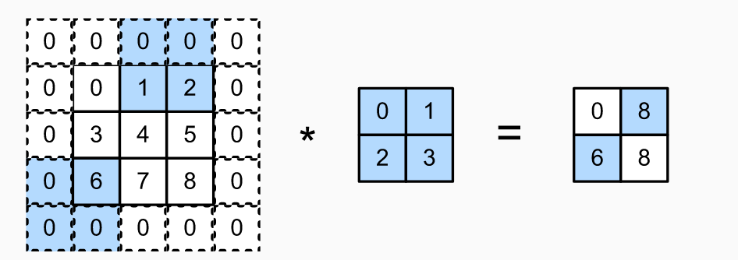

Convolutional Neural Networks
Stride: $\frac{n+2p−f}{S}+1, S \text{= }\text{How} \text{many} \text{pixels} \text{to} \text{slide} \text{the} \text{filter} \text{at} \text{each} \text{step}\text{.}$
“Stride”: How many pixels to slide the filter at each step.
model.add(Conv2D(64, 8, 8, input_shape=(64, 64, 1), padding='same', activation='relu'))

Slide 13
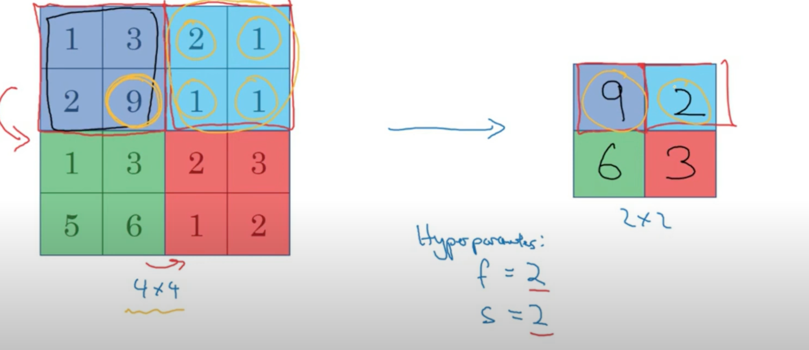
Max Pooling
model.add(MaxPooling2D(pool_size=(2, 2)))

Slide 14
Review: Convolutional Layers In Keras
“Kernel_Size”: How many pixels (square) should each filter examine.
## Convolutional Layer
model.add(Conv2D(64, 8, 8, input_shape=(64, 64, 1), padding='same', activation='relu'))
## Pooling Layer
model.add(MaxPooling2D(pool_size=(2, 2)))
“Stride”: How many pixels to slide the filter at each step.
Number of Filters
Size of the Region to pool
Warning: Making sure that dimensions make sense can be more challenging convolutional networks than in feed forward.

Slide 15

Convolutional Neural Networks Convolutional layers
Convolutional layers, which use the same weights on sliding windows across the entire image
Can be viewed as a set of filters, which have been trained to recognize certain structures in the image
“Examine” what’s in a particular window of the image
Weights are fixed no matter which part of the image they are examining
Each filter is to see some type of visual feature, such as the edge of some orientation or a blotch of some color, or eventually entire honeycomb or wheel-like patterns

Slide 16
Convolutional Neural Networks Pooling Layers
Pooling layers, where output from earlier layers is combined and reduced
Used to progressively reduce the spatial size of the representation to reduce the amount of parameters and computation in the network
Hence, it controls overfitting
Two types include “max pooling” and “average pooling,” which select the maximum or average value, respectively, of activations over an area of the image, rather than every activation

Slide 17
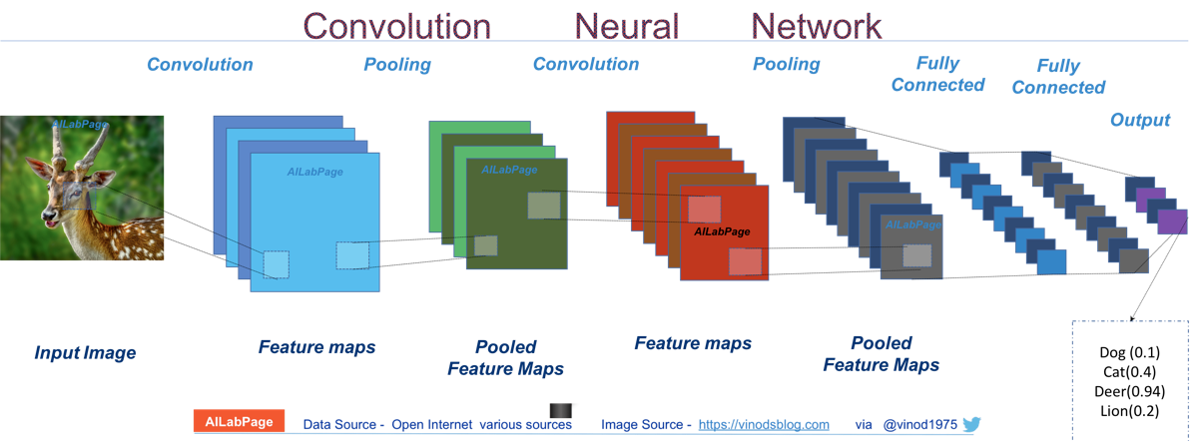
Convolutional Neural Networks Layers
These layers provide at least two benefits:
Provide a way to recognize signals (and therefore objects) no matter where they are located in the image
Reduce the total number of weights learned in the network, improving training

Slide 18

Convolutional Neural Networks Wrap-Up
Models discussed
Convolutional neural networks
Tools discussed
TensorFlow and Keras
Examples discussed
Facial recognition
Animating photos

